Slide 1

Improved Product Recommendation System

Slide 2
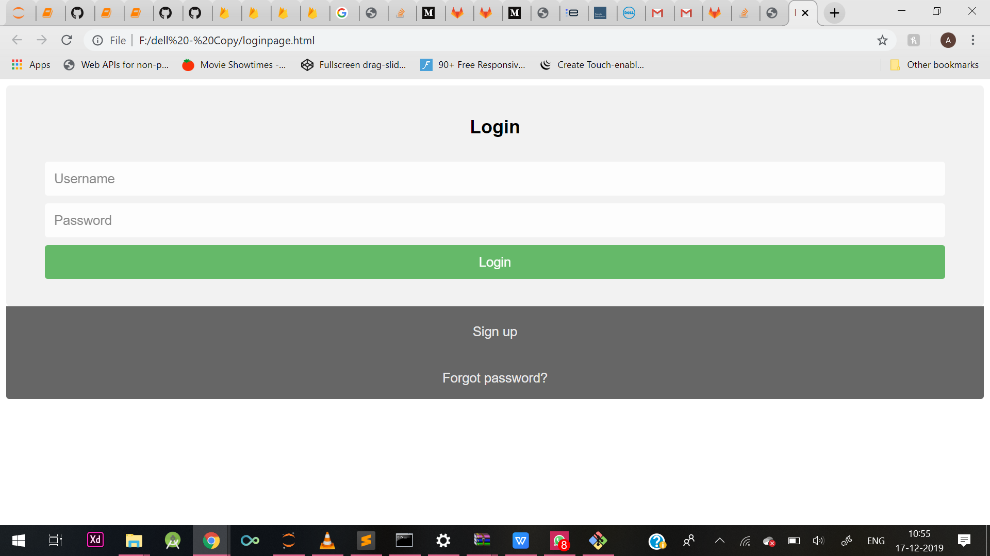

Slide 3
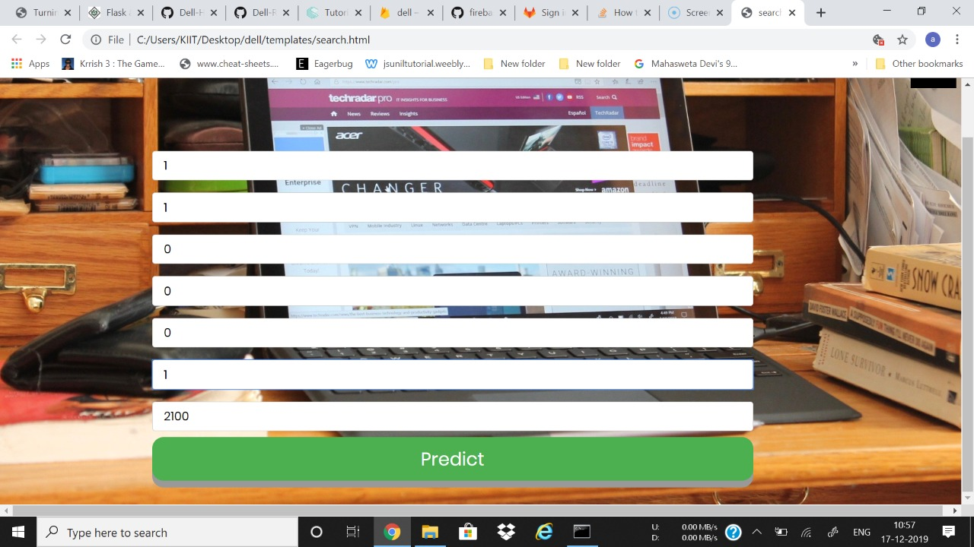

Slide 4
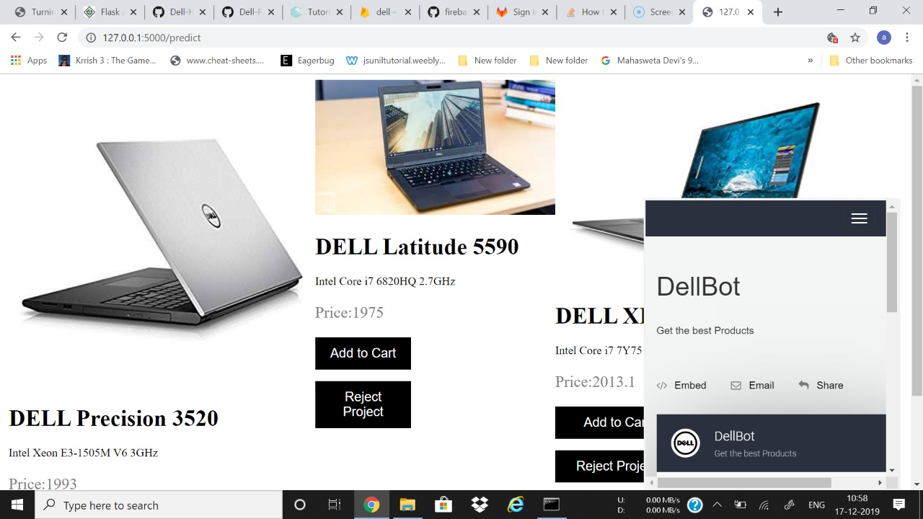

Slide 5
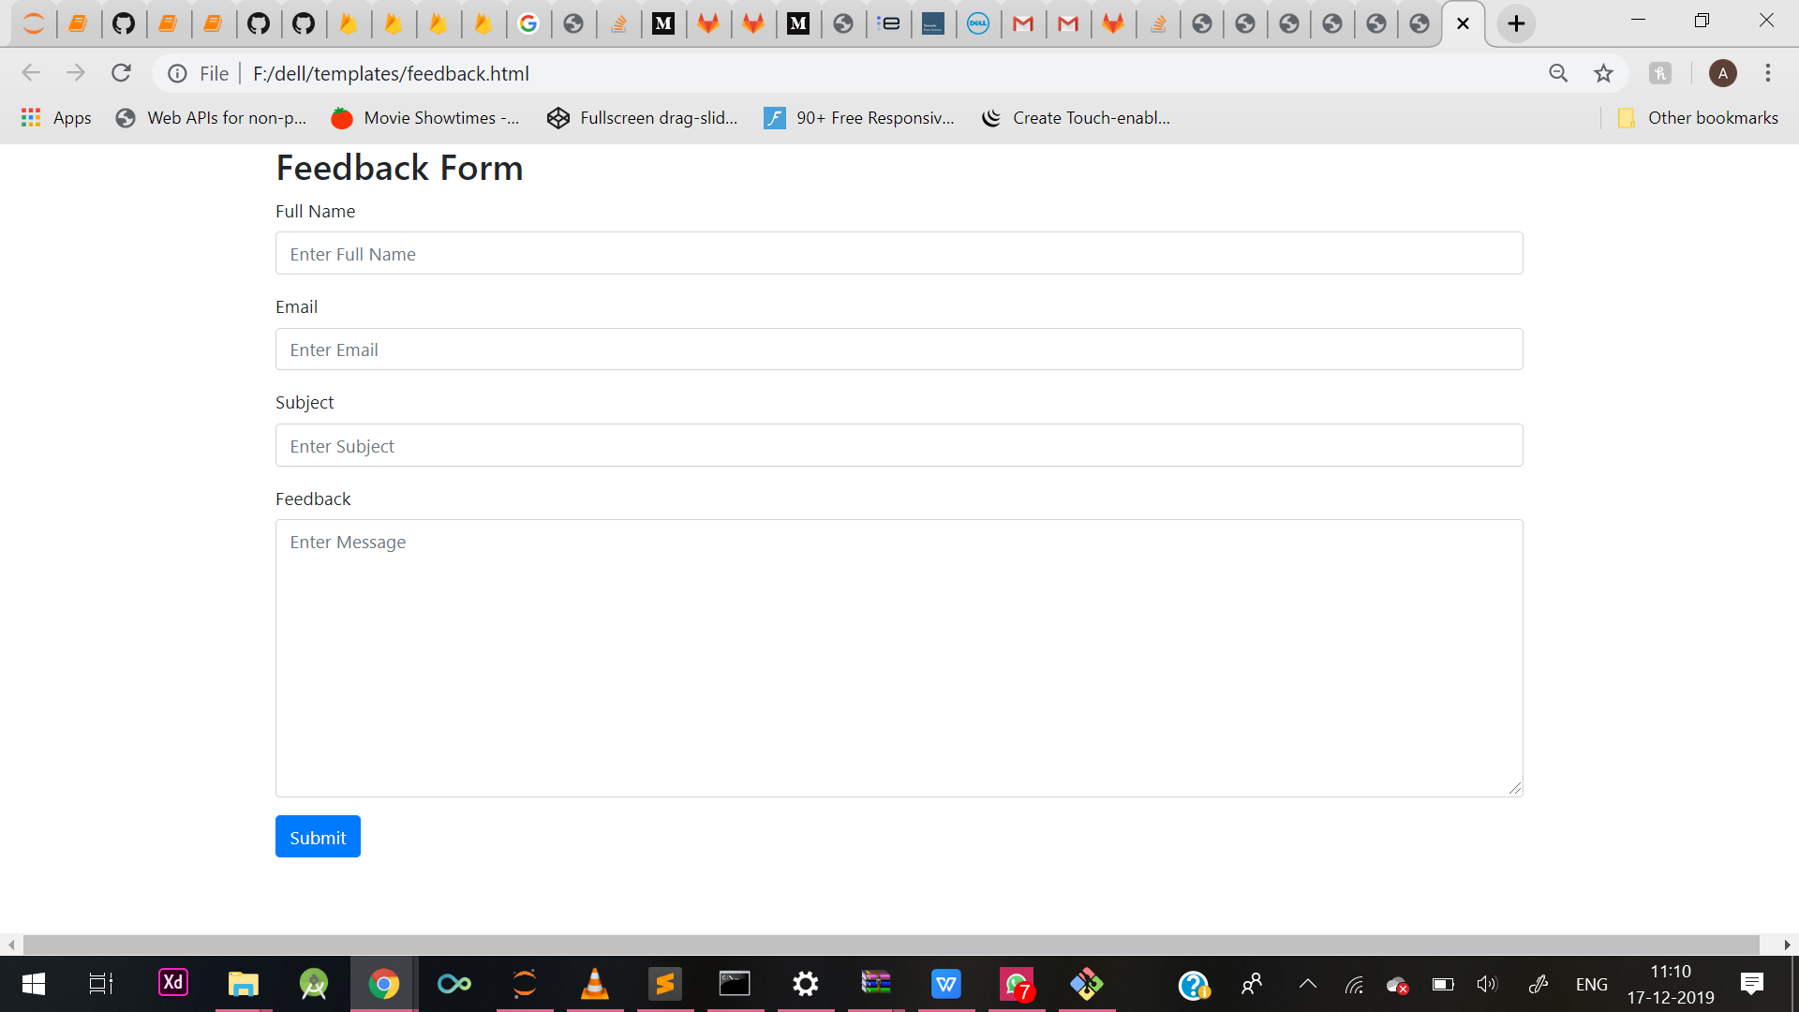

Slide 6
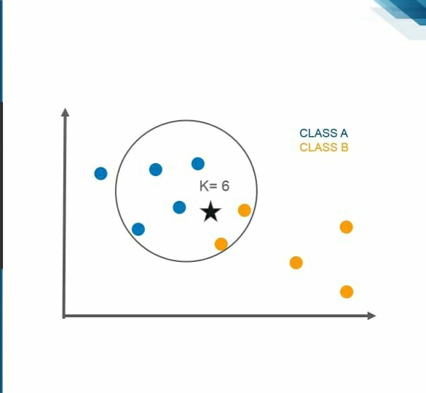
What is KNN?
K Nearest Neighbour is a simple algorithm that stores all the available cases and classifies the new data or case based on a similarity.

Slide 7
Advantages Of KNN
The algorithm is simple and easy to implement
There's no need to build a model, tune several parameters, or make additional assumptions
The algorithm is versatile. It can be used for classification, regression, and search

Slide 8
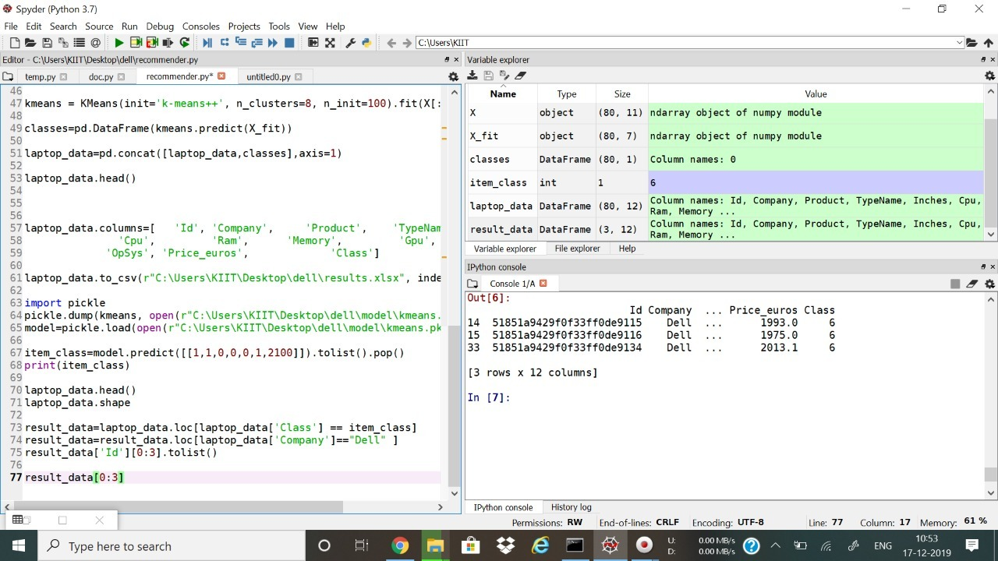

Slide 9
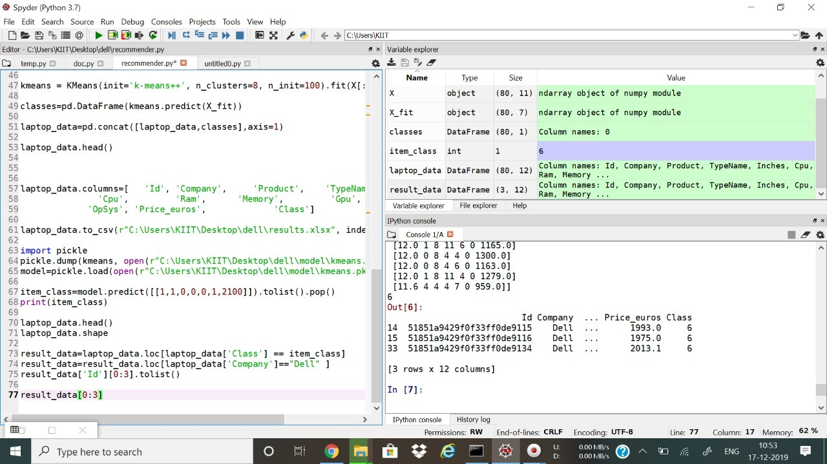

Slide 10
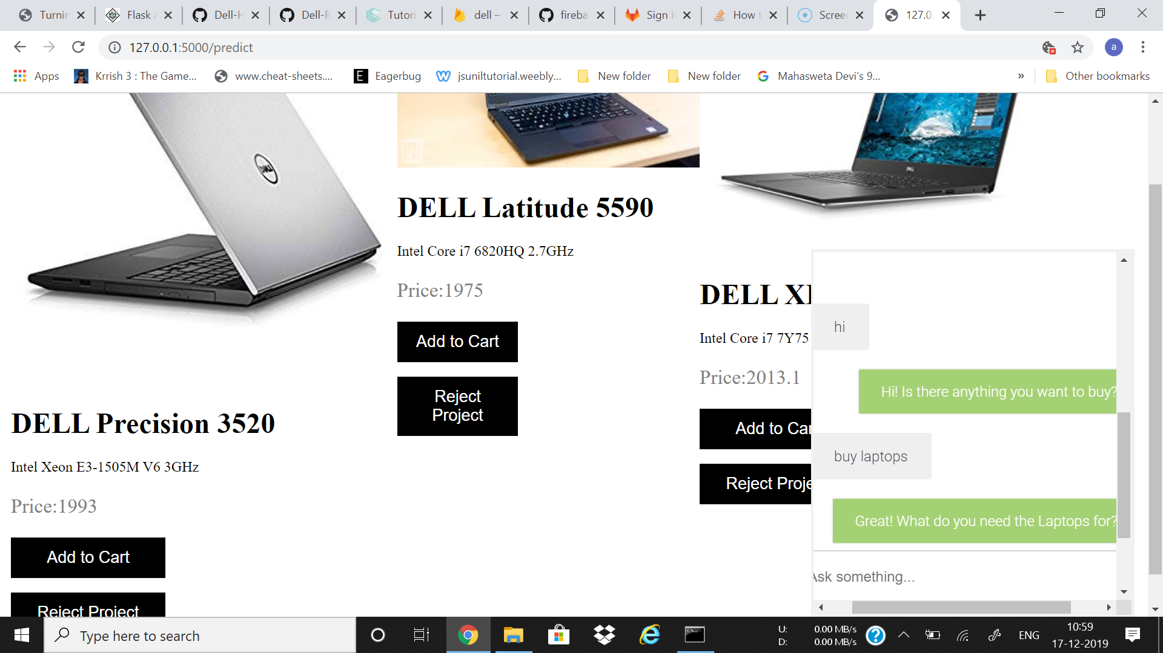

Slide 11
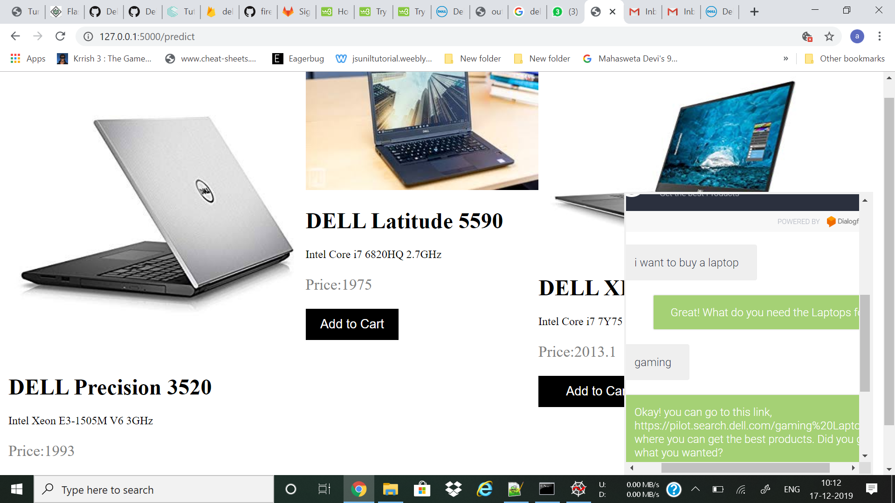

Slide 12
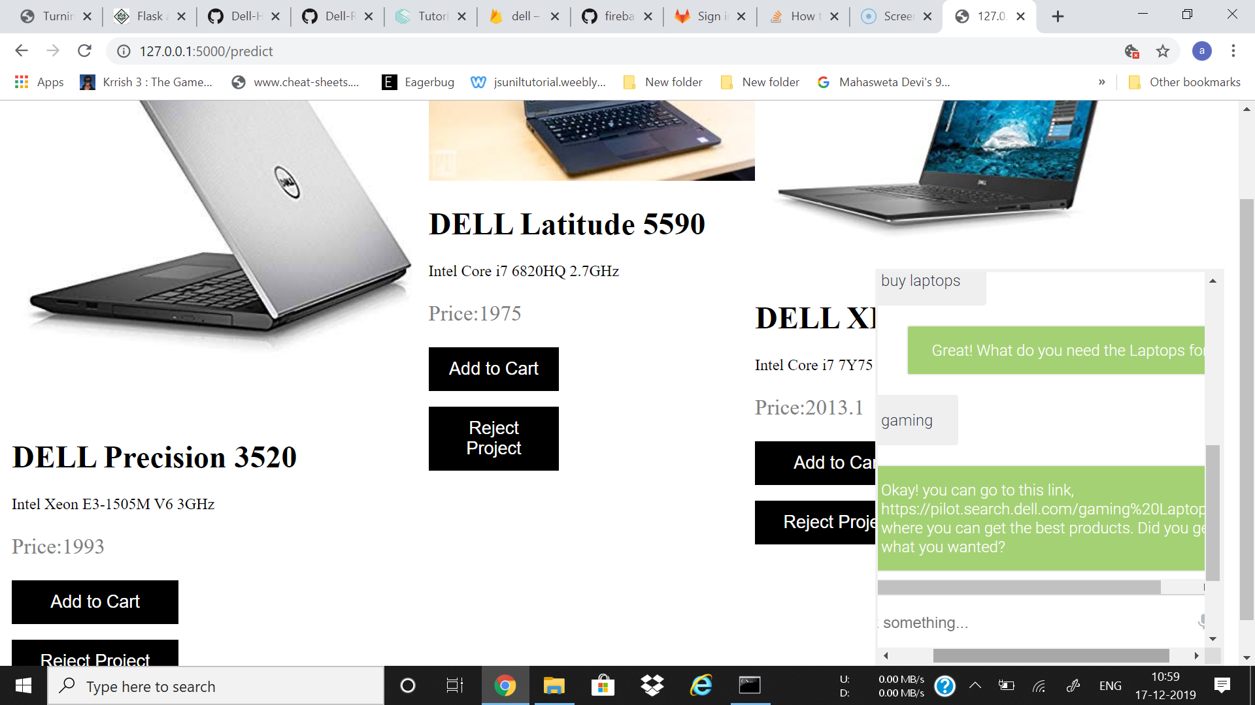

Slide 13
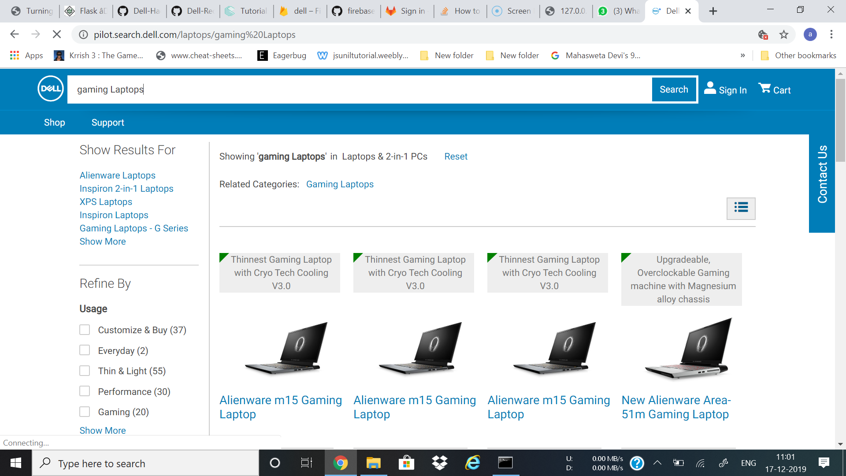

Slide 14
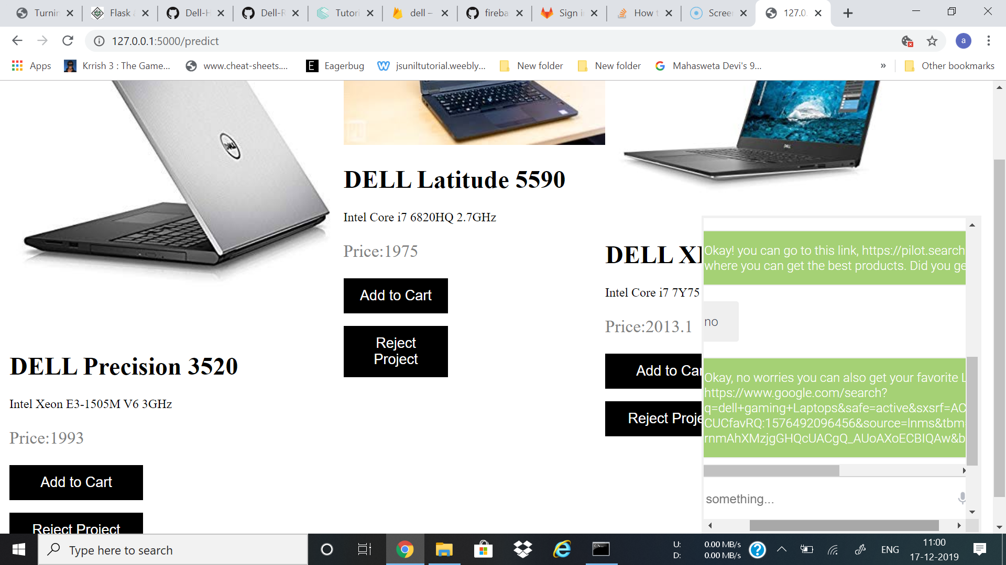

Slide 15
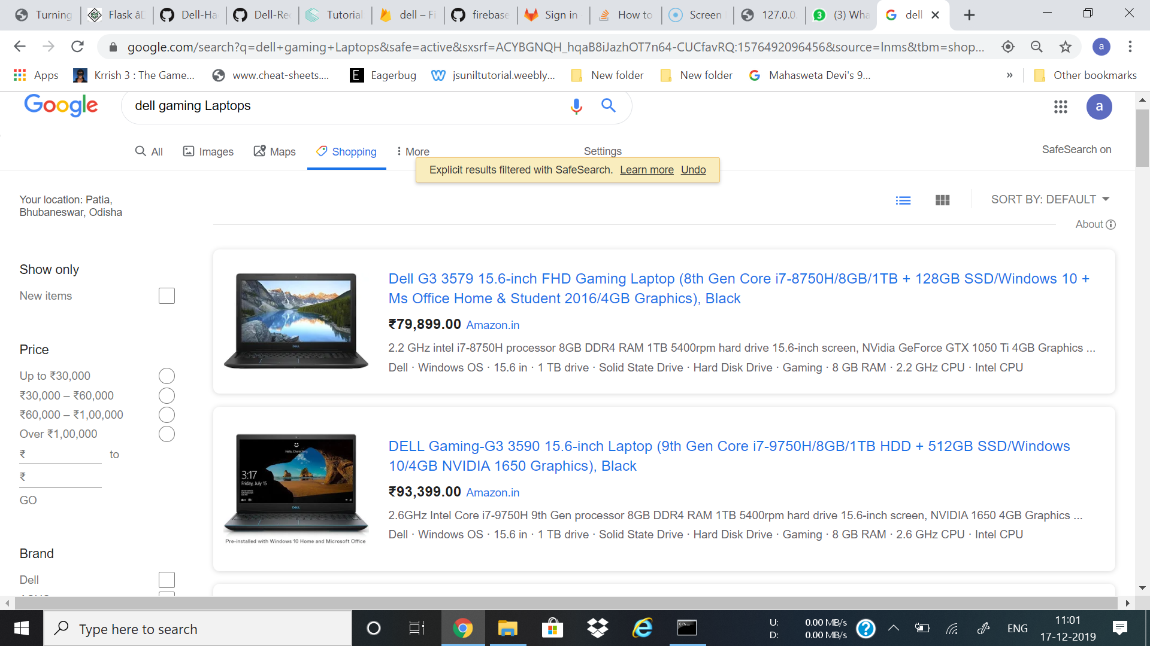

Slide 16
Demonstration

Slide 17
Future Scope and Improvement
Email Notification for better deals and cart reminders
Use of Google AdSense to get recommendations for related products through Chatbot
Using a ChatBot Survey for ColdStart Users
Determining location of customer's IP address and training a model to predict the delivery time

Slide 18
Business Aspects
Improving with use
Personalised Experience
Higher Conversion Rate
Improving Cart Value
Improved engagement and delight

Slide 19
Thank You

